Slide 1

Sprocket Central Pty Ltd
Data analytics approach
Marketing Strategy – Akshata Bodhankar

Slide 2
Agenda
Data Exploration
Model Development
Cluster Characteristics
Targeting

Slide 3
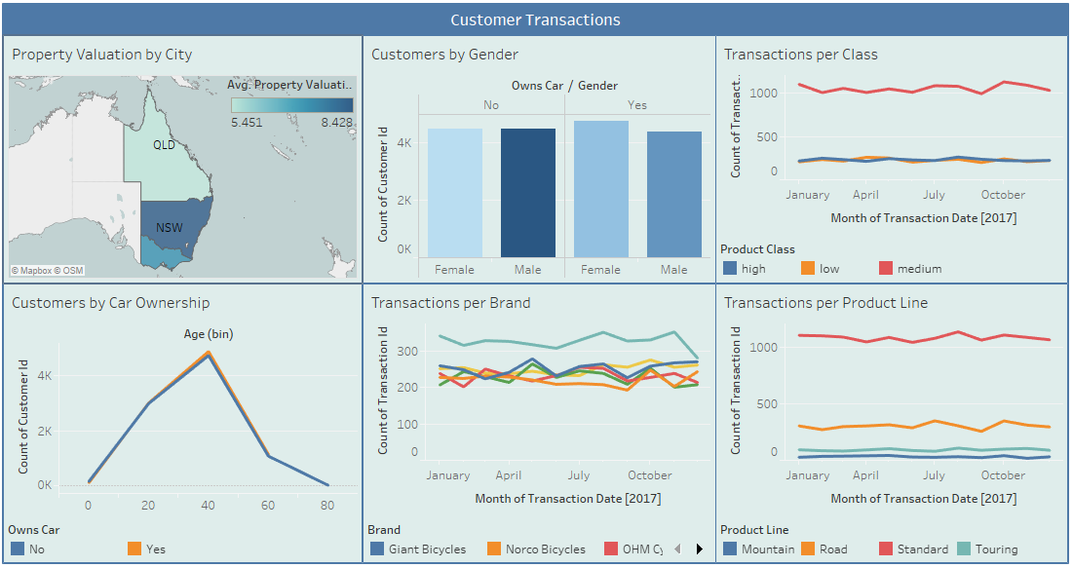
Initial analysis of customers revealed that the age group of 40-60 is more prominent and so is so is Solex. But Solex’s cycles saw huge dip in November 2017.

Slide 4
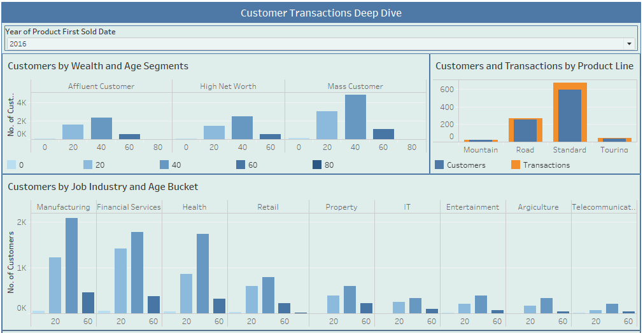
There are more than one transactions per customer for the standard product line. Also, the age group 40-60 from 3 industries is influencing the increase in transactions in this age group.

Slide 5
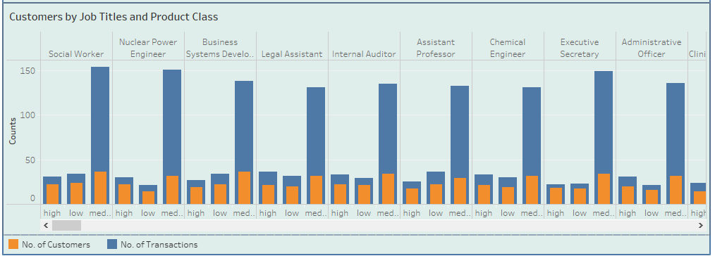
An infrequent customer is more likely to take a high or low class product irrespective of their job

Slide 6
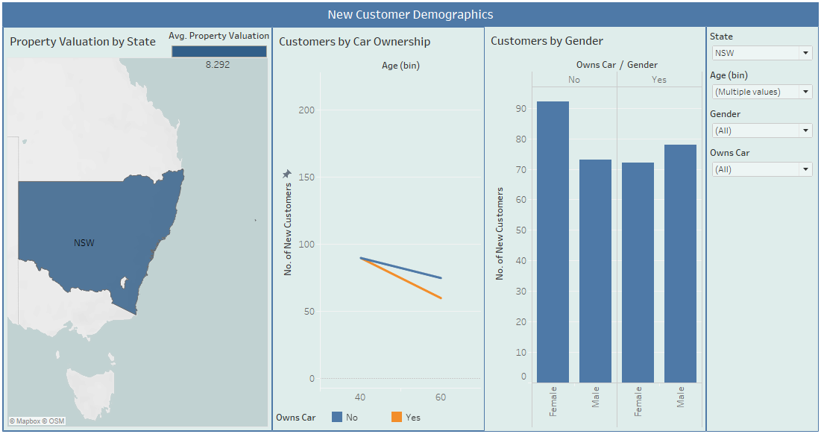
Unexpectedly, there are more females among the new customers aged between 40 and 80 in New South Wales, that don’t own a car

Slide 7
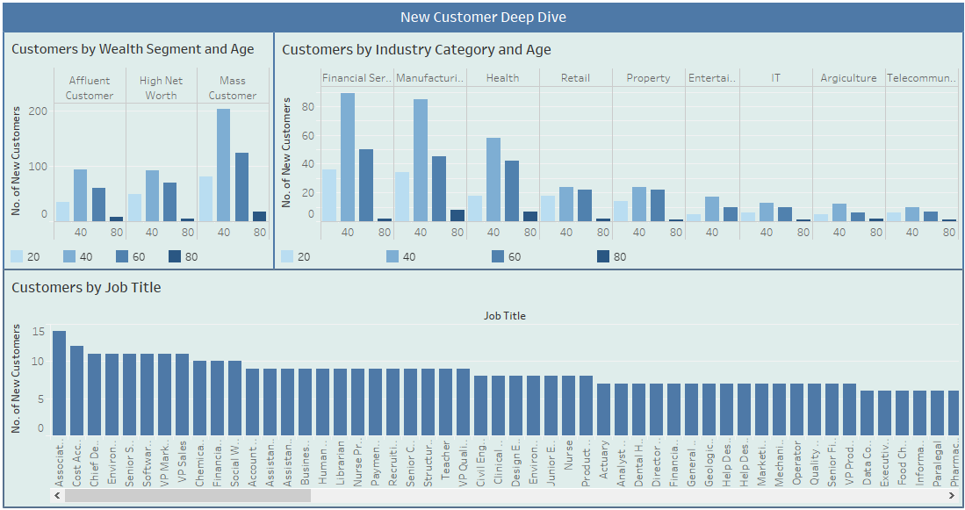
Contrary to existing customers, there are more associate professors than social service people in the new customers

Slide 8
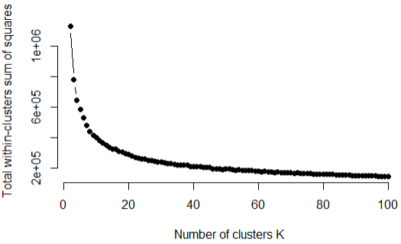
Using those columns to cluster and then classify customers gives an accuracy and average sensitivity of 78%
k=36 appears to be the elbow and hence the optimal number of clusters we must consider
Each of the cluster is characterized by different titles and job industry categories

Slide 9
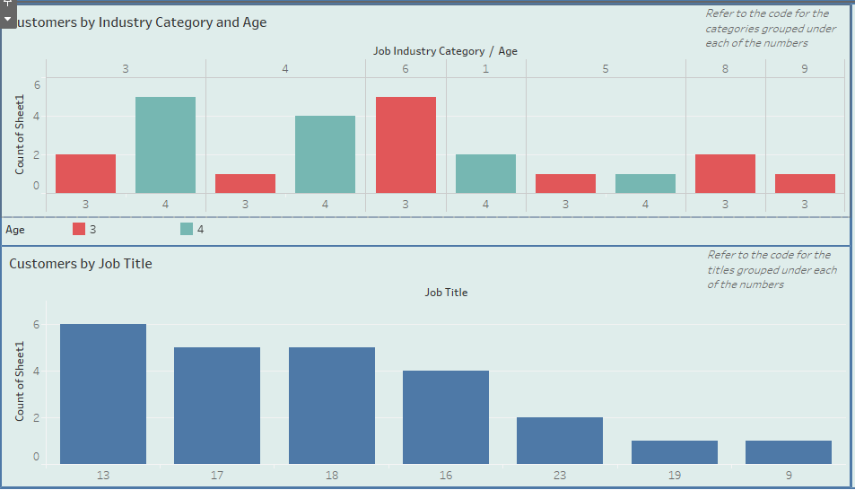
Cluster characteristics are predominantly defined by different job industry category, age group and job title
For example, customers in cluster 1 belong to 40-60 age group; finance, health and manufacturing job industry category; engineer, data related and healthcare related job titles

Slide 10
Appendix

Slide 11
R Code
---
title: "KPMG Virtual Internship"
author: "Akshata Bodhankar"
date: "8/19/2020"
output: html_document
---
```{r setup, include=FALSE}
knitr::opts_chunk$set(echo = TRUE)
pacman::p_load(readxl, writexl, ggplot2, ggcorrplot, dplyr, MASS, caret, rpart, rpart.plot, rattle, caret)
#library(readxl)
#install.packages("writexl", dependencies = T)
#library(writexl)
#install.packages("ggcorrplot")
#library(ggplot2)
#library(ggcorrplot)
#library(dplyr)
#library(MASS)
#library(caret)
```
```{r data}
custDemo <- read_excel("C:\\Users\\aksha\\Documents\\kpmg virtual internship\\KPMG_VI_New_raw_data_update_final (version 2).xlsx", sheet = 2)
custAdd <- read_excel("C:\\Users\\aksha\\Documents\\kpmg virtual internship\\KPMG_VI_New_raw_data_update_final (version 2).xlsx", sheet = 3)
Transactions <- read_excel("C:\\Users\\aksha\\Documents\\kpmg virtual internship\\KPMG_VI_New_raw_data_update_final (version 2).xlsx", sheet = 4)
newCust <- read_excel("C:\\Users\\aksha\\Documents\\kpmg virtual internship\\KPMG_VI_New_raw_data_update_final (version 2).xlsx", sheet = 5)
```
## Convert to data table:
```{r pressure, echo=FALSE}
library(data.table)
custDemo.dt <- as.data.table(custDemo)
custAdd.dt <- as.data.table(custAdd)
Transactions.dt <- as.data.table(Transactions)
newCust.dt <- as.data.table(newCust)
```
## Join Address and demographics table
```{r join}
existingCust <- merge(custDemo.dt, custAdd.dt, by.x = "customer_id", by.y = "customer_id", all = T)
existingCustTrans <- merge(existingCust, Transactions.dt, by.x = "customer_id", by.y = "customer_id", all = T)
```
## Computing basic statistics for customer demographics:
```{r stats}
# Compute Statistics - mean, standard dev, min, max, median, length,
custDemo.dt[, .(mean=mean(past_3_years_bike_related_purchases), sd=sd(past_3_years_bike_related_purchases),
minimum=min(past_3_years_bike_related_purchases), maximum=max(past_3_years_bike_related_purchases),
median=median(past_3_years_bike_related_purchases)), by=Gender]
```
## Converting gender and job title
```{r converts}
cust.dt <- existingCustTrans[, c(-2, -3, -6, -12, -15)]
cust.dt <- within(cust.dt, Gender[grep('Female', Gender, ignore.case = T)] <- 1)
cust.dt <- within(cust.dt, Gender[grep('Male', Gender, ignore.case = T)] <- 0)
cust.dtNew <- within(cust.dt, job_title[grep('editor', job_title, ignore.case = T)] <- 1)
cust.dtNew <- within(cust.dtNew, job_title[grep('consultant', job_title, ignore.case = T)] <- 2)
cust.dtNew <- within(cust.dtNew, job_title[grep('programmer', job_title, ignore.case = T)] <- 3)
cust.dtNew <- within(cust.dtNew, job_title[grep('recruit', job_title, ignore.case = T)] <- 4)
cust.dtNew <- within(cust.dtNew, job_title[grep('legal', job_title, ignore.case = T)] <- 5)
cust.dtNew <- within(cust.dtNew, job_title[grep('payment', job_title, ignore.case = T)] <- 5)
cust.dtNew <- within(cust.dtNew, job_title[grep('research', job_title, ignore.case = T)] <- 6)
cust.dtNew <- within(cust.dtNew, job_title[grep('operator', job_title, ignore.case = T)] <- 7)
cust.dtNew <- within(cust.dtNew, job_title[grep('account', job_title, ignore.case = T)] <- 8)
cust.dtNew <- within(cust.dtNew, job_title[grep('actua', job_title, ignore.case = T)] <- 8)
cust.dtNew <- within(cust.dtNew, job_title[grep('admin', job_title, ignore.case = T)] <- 9)
cust.dtNew <- within(cust.dtNew, job_title[grep('teacher', job_title, ignore.case = T)] <- 10)
cust.dtNew <- within(cust.dtNew, job_title[grep('professor', job_title, ignore.case = T)] <- 10)
cust.dtNew <- within(cust.dtNew, job_title[grep('autom', job_title, ignore.case = T)] <- 11)
cust.dtNew <- within(cust.dtNew, job_title[grep('biostat', job_title, ignore.case = T)] <- 12)
cust.dtNew <- within(cust.dtNew, job_title[grep('scien', job_title, ignore.case = T)] <- 12)
cust.dtNew <- within(cust.dtNew, job_title[grep('engineer', job_title, ignore.case = T)] <- 13)
cust.dtNew <- within(cust.dtNew, job_title[grep('specialist', job_title, ignore.case = T)] <- 14)
cust.dtNew <- within(cust.dtNew, job_title[grep('statistician', job_title, ignore.case = T)] <- 15)
cust.dtNew <- within(cust.dtNew, job_title[grep('sales', job_title, ignore.case = T)] <- 16)
cust.dtNew <- within(cust.dtNew, job_title[grep('analyst', job_title, ignore.case = T)] <- 17)
cust.dtNew <- within(cust.dtNew, job_title[grep('data', job_title, ignore.case = T)] <- 17)
cust.dtNew <- within(cust.dtNew, job_title[grep('dental', job_title, ignore.case = T)] <- 18)
cust.dtNew <- within(cust.dtNew, job_title[grep('health', job_title, ignore.case = T)] <- 18)
cust.dtNew <- within(cust.dtNew, job_title[grep('nurse', job_title, ignore.case = T)] <- 18)
cust.dtNew <- within(cust.dtNew, job_title[grep('therap', job_title, ignore.case = T)] <- 18)
cust.dtNew <- within(cust.dtNew, job_title[grep('pharmacist', job_title, ignore.case = T)] <- 18)
cust.dtNew <- within(cust.dtNew, job_title[grep('pathologist', job_title, ignore.case = T)] <- 18)
cust.dtNew <- within(cust.dtNew, job_title[grep('chemist', job_title, ignore.case = T)] <- 18)
cust.dtNew <- within(cust.dtNew, job_title[grep('techn', job_title, ignore.case = T)] <- 19)
cust.dtNew <- within(cust.dtNew, job_title[grep('developer', job_title, ignore.case = T)] <- 20)
cust.dtNew <- within(cust.dtNew, job_title[grep('editor', job_title, ignore.case = T)] <- 21)
cust.dtNew <- within(cust.dtNew, job_title[grep('director', job_title, ignore.case = T)] <- 22)
cust.dtNew <- within(cust.dtNew, job_title[grep('environ', job_title, ignore.case = T)] <- 23)
cust.dtNew <- within(cust.dtNew, job_title[grep('secretary', job_title, ignore.case = T)] <- 24)
cust.dtNew <- within(cust.dtNew, job_title[grep('advisor', job_title, ignore.case = T)] <- 25)
cust.dtNew <- within(cust.dtNew, job_title[grep('geologist', job_title, ignore.case = T)] <- 26)
cust.dtNew <- within(cust.dtNew, job_title[grep('manag', job_title, ignore.case = T)] <- 27)
cust.dtNew <- within(cust.dtNew, job_title[grep('designer', job_title, ignore.case = T)] <- 28)
cust.dtNew <- within(cust.dtNew, job_title[grep('help desk', job_title, ignore.case = T)] <- 29)
cust.dtNew <- within(cust.dtNew, job_title[grep('human resour', job_title, ignore.case = T)] <- 30)
cust.dtNew <- within(cust.dtNew, job_title[grep('auditor', job_title, ignore.case = T)] <- 31)
cust.dtNew <- within(cust.dtNew, job_title[grep('exec', job_title, ignore.case = T)] <- 32)
cust.dtNew <- within(cust.dtNew, job_title[grep('librarian', job_title, ignore.case = T)] <- 33)
cust.dtNew <- within(cust.dtNew, job_title[grep('marketing', job_title, ignore.case = T)] <- 34)
cust.dtNew <- within(cust.dtNew, job_title[grep('media', job_title, ignore.case = T)] <- 35)
cust.dtNew <- within(cust.dtNew, job_title[grep('quality', job_title, ignore.case = T)] <- 36)
cust.dtNew <- within(cust.dtNew, job_title[grep('social', job_title, ignore.case = T)] <- 37)
cust.dtNew <- within(cust.dtNew, job_title[grep('assist', job_title, ignore.case = T)] <- 24)
cust.dtNew <- within(cust.dtNew, job_title[is.na(job_title)] <- 0)
```
## Converting job industry category
```{r job industry}
cust.dtNew <- within(cust.dtNew, job_industry_category[grep('argi', job_industry_category, ignore.case = T)] <- 1)
cust.dtNew <- within(cust.dtNew, job_industry_category[grep('entert', job_industry_category, ignore.case = T)] <- 2)
cust.dtNew <- within(cust.dtNew, job_industry_category[grep('finan', job_industry_category, ignore.case = T)] <- 3)
cust.dtNew <- within(cust.dtNew, job_industry_category[grep('healt', job_industry_category, ignore.case = T)] <- 4)
cust.dtNew <- within(cust.dtNew, job_industry_category[grep('IT', job_industry_category, ignore.case = F)] <- 5)
cust.dtNew <- within(cust.dtNew, job_industry_category[grep('manuf', job_industry_category, ignore.case = T)] <- 6)
cust.dtNew <- within(cust.dtNew, job_industry_category[grep('n/a', job_industry_category, ignore.case = T)] <- 0)
cust.dtNew <- within(cust.dtNew, job_industry_category[grep('proper', job_industry_category, ignore.case = T)] <- 7)
cust.dtNew <- within(cust.dtNew, job_industry_category[grep('retail', job_industry_category, ignore.case = T)] <- 8)
cust.dtNew <- within(cust.dtNew, job_industry_category[grep('telecom', job_industry_category, ignore.case = T)] <- 9)
```
## Converting wealth segment
```{r wealth}
cust.dtNew <- within(cust.dtNew, wealth_segment[grep('afflu', wealth_segment, ignore.case = T)] <- 1)
cust.dtNew <- within(cust.dtNew, wealth_segment[grep('high', wealth_segment, ignore.case = T)] <- 2)
cust.dtNew <- within(cust.dtNew, wealth_segment[grep('mass', wealth_segment, ignore.case = T)] <- 3)
```
## Converting deceased indicator and car ownership
```{r life indicator}
cust.dtNew <- within(cust.dtNew, deceased_indicator[grep('N', deceased_indicator, ignore.case = T)] <- 0)
cust.dtNew <- within(cust.dtNew, deceased_indicator[grep('Y', deceased_indicator, ignore.case = T)] <- 1)
cust.dtNew <- within(cust.dtNew, owns_car[grep('No', owns_car, ignore.case = T)] <- 0)
cust.dtNew <- within(cust.dtNew, owns_car[grep('Yes', owns_car, ignore.case = T)] <- 1)
```
## Creating age buckets
```{r age bucketing}
cust.dtNew <- within(cust.dtNew, Age[Age<=20] <- 1)
cust.dtNew <- within(cust.dtNew, Age[Age>20 & Age <=40] <- 2)
cust.dtNew <- within(cust.dtNew, Age[Age>40 & Age<=60] <- 3)
cust.dtNew <- within(cust.dtNew, Age[Age>60 & Age<=80] <- 4)
cust.dtNew <- within(cust.dtNew, Age[Age>80] <- 5)
#write_xlsx(cust.dtNew, "C:\\Users\\aksha\\Documents\\kpmg virtual internship\\Customer_Demo_New.xlsx")
```
## Remove customers with no gender
```{r drop}
cust.dtNew2 <- cust.dtNew[!is.na(cust.dtNew$Gender)]
#write_xlsx(cust.dtNew, "C:\\Users\\aksha\\Documents\\kpmg virtual internship\\Customer_Demo_New.xlsx")
```
Also, from the Tableau workbook, we observe that:
1. Most purchases are made by people of age group 40 and 60
2. Accountants, Actuaries and Engineers have highest number of transactions but it may be because these type of customers are also more in number.
3. High and low product class are sold in comparable numbers. But medium are most popular.
4. Very less consultants buy bikes followed by people working in fields related to environment and financial advisors
5. Medium size and product line standard are most popular
## Removing more columns and making others categorical
```{r drop again}
cust.dtNew2 <- cust.dtNew2[, c(-11, -14, -16)]
cust.dtNew2[, State := ifelse(State=='NSW', 1, ifelse(State=='QLD', 2, 3))]
cust.dtNew2[, transaction_month := month(transaction_date)]
cust.dtNew2[, transaction_year := year(transaction_date)]
cust.dtNew2[, Online_Order := ifelse(Online_Order=='FALSE', 0, 1)]
cust.dtNew2[, order_status := ifelse(order_status=='Cancelled', 0, 1)]
cust.dtNew2[, brand := ifelse(brand=='Giant Bicycles', 1, ifelse(brand=='Norco Bicycles', 2, ifelse(brand=='OHM Cycles', 3, ifelse(brand=='Solex', 4, ifelse(brand=='Trek Bicycles', 5, 6)))))]
cust.dtNew2[, product_line := ifelse(product_line=='Mountain', 1, ifelse(product_line=='Road', 2, ifelse(product_line=='Standard', 3, 4)))]
cust.dtNew2[, product_class := ifelse(product_class=='low', 1, ifelse(product_class=='medium', 2, 3))]
cust.dtNew2[, product_size := ifelse(product_size=='small', 1, ifelse(product_size=='medium', 2, 3))]
cust.dtNew2[, product_first_sold_month := month(product_first_sold_date)]
cust.dtNew2[, product_first_sold_year := year(product_first_sold_date)]
cust.dtNew2a <- cust.dtNew2[, c(-15, -24)]
write_xlsx(cust.dtNew2a, "C:\\Users\\aksha\\Documents\\kpmg virtual internship\\Customer_Demo_New2.xlsx")
#450 people do not have transactions. Let's remove them too.
cust.dtNew3 <- cust.dtNew2a[!is.na(cust.dtNew2$product_id)]
```
## Convert data to customer level
```{r data conversion}
cust.df <- as.data.frame(cust.dtNew3[, c(-14, -16, -24)])
cust.df2 <- cust.df %>% group_by(customer_id, Gender, past_3_years_bike_related_purchases, Age, job_title, job_industry_category, wealth_segment, deceased_indicator, owns_car, tenure, postcode, State, property_valuation) %>% summarise(Online_Order = round(mean(Online_Order)), brand = round(mean(brand)), product_line = round(mean(product_line)), product_class = round(mean(product_class)), product_size = round(mean(product_size)), list_price = round(mean(list_price)), standard_cost = round(mean(standard_cost)), transaction_month = round(mean(transaction_month)), product_first_sold_month = round(mean(product_first_sold_month)), product_first_sold_year = round(mean(product_first_sold_year)))
```
## Clustering
```{r clustering}
#Elbow Method for finding the optimal number of clusters
# Compute and plot wss for k = 2 to k = 15.
k.max <- 100
data <- cust.df2[, c(2:10, 13, 23)]
set.seed(123)
wss <- sapply(2:k.max,
function(k){kmeans(data, k, iter.max = 11)$tot.withinss})
wss
plot(2:k.max, wss,
type="b", pch = 19, frame = FALSE,
xlab="Number of clusters K",
ylab="Total within-clusters sum of squares")
```
k=36 appears to be the elbow and hence the optimal number of clusters we must consider.
## Labeling clusters in data
```{r label cuslter}
set.seed(123)
km <- kmeans(x = cust.df2[, c(2:10, 13, 23)], 36)
cust.df2$cluster <- km$cluster
```
## Train and Test Data
```{r train}
# remove the columns which are not present in the list of potential customers
cust.df.model <- cust.df2[, c(2:10, 13, 24)]
#train 70 test 30
set.seed(123)
train.index <- sample(c(1:nrow(cust.df.model)), round(0.7 * nrow(cust.df.model)))
train.df <- cust.df.model[train.index, ]
test.df <- cust.df.model[-train.index, ]
```
## Classification model
```{r LDA classifier}
set.seed(123)
lda.train <- lda(cluster~., data = train.df)
#lda.train
# Predict - using Validation data
pred.test <- predict(lda.train, test.df)
names(pred.test)
#pred.test
# Confusion matrix
acc1 <- table(pred.test$class, test.df$cluster) # pred v actual
confusionMatrix(acc1)
```
So, we get an accuracy of 95.9% using LDA
Now let's work on the new customers data set
```{r new customers}
newCust_sub <- newCust.dt[, c(3, 4, 6, 7, 8, 9, 10, 11, 12, 18)]
newCust_sub <- within(newCust_sub, Age[Age<=20] <- 1)
newCust_sub <- within(newCust_sub, Age[Age>20 & Age <=40] <- 2)
newCust_sub <- within(newCust_sub, Age[Age>40 & Age<=60] <- 3)
newCust_sub <- within(newCust_sub, Age[Age>60 & Age<=80] <- 4)
newCust_sub <- within(newCust_sub, Age[Age>80] <- 5)
newCust_sub$Gender <- newCust_sub$gender
newCust_sub$gender <- NULL
newCust_sub <- within(newCust_sub, Gender[grep('Female', Gender, ignore.case = T)] <- 1)
newCust_sub <- within(newCust_sub, Gender[grep('Male', Gender, ignore.case = T)] <- 0)
newCust_sub <- within(newCust_sub, job_title[grep('editor', job_title, ignore.case = T)] <- 1)
newCust_sub <- within(newCust_sub, job_title[grep('consultant', job_title, ignore.case = T)] <- 2)
newCust_sub <- within(newCust_sub, job_title[grep('programmer', job_title, ignore.case = T)] <- 3)
newCust_sub <- within(newCust_sub, job_title[grep('recruit', job_title, ignore.case = T)] <- 4)
newCust_sub <- within(newCust_sub, job_title[grep('legal', job_title, ignore.case = T)] <- 5)
newCust_sub <- within(newCust_sub, job_title[grep('payment', job_title, ignore.case = T)] <- 5)
newCust_sub <- within(newCust_sub, job_title[grep('research', job_title, ignore.case = T)] <- 6)
newCust_sub <- within(newCust_sub, job_title[grep('operator', job_title, ignore.case = T)] <- 7)
newCust_sub <- within(newCust_sub, job_title[grep('account', job_title, ignore.case = T)] <- 8)
newCust_sub <- within(newCust_sub, job_title[grep('actua', job_title, ignore.case = T)] <- 8)
newCust_sub <- within(newCust_sub, job_title[grep('admin', job_title, ignore.case = T)] <- 9)
newCust_sub <- within(newCust_sub, job_title[grep('teacher', job_title, ignore.case = T)] <- 10)
newCust_sub <- within(newCust_sub, job_title[grep('professor', job_title, ignore.case = T)] <- 10)
newCust_sub <- within(newCust_sub, job_title[grep('autom', job_title, ignore.case = T)] <- 11)
newCust_sub <- within(newCust_sub, job_title[grep('biostat', job_title, ignore.case = T)] <- 12)
newCust_sub <- within(newCust_sub, job_title[grep('scien', job_title, ignore.case = T)] <- 12)
newCust_sub <- within(newCust_sub, job_title[grep('engineer', job_title, ignore.case = T)] <- 13)
newCust_sub <- within(newCust_sub, job_title[grep('specialist', job_title, ignore.case = T)] <- 14)
newCust_sub <- within(newCust_sub, job_title[grep('statistician', job_title, ignore.case = T)] <- 15)
newCust_sub <- within(newCust_sub, job_title[grep('sales', job_title, ignore.case = T)] <- 16)
newCust_sub <- within(newCust_sub, job_title[grep('analyst', job_title, ignore.case = T)] <- 17)
newCust_sub <- within(newCust_sub, job_title[grep('data', job_title, ignore.case = T)] <- 17)
newCust_sub <- within(newCust_sub, job_title[grep('dental', job_title, ignore.case = T)] <- 18)
newCust_sub <- within(newCust_sub, job_title[grep('health', job_title, ignore.case = T)] <- 18)
newCust_sub <- within(newCust_sub, job_title[grep('nurse', job_title, ignore.case = T)] <- 18)
newCust_sub <- within(newCust_sub, job_title[grep('therap', job_title, ignore.case = T)] <- 18)
newCust_sub <- within(newCust_sub, job_title[grep('pharmacist', job_title, ignore.case = T)] <- 18)
newCust_sub <- within(newCust_sub, job_title[grep('pathologist', job_title, ignore.case = T)] <- 18)
newCust_sub <- within(newCust_sub, job_title[grep('chemist', job_title, ignore.case = T)] <- 18)
newCust_sub <- within(newCust_sub, job_title[grep('techn', job_title, ignore.case = T)] <- 19)
newCust_sub <- within(newCust_sub, job_title[grep('developer', job_title, ignore.case = T)] <- 20)
newCust_sub <- within(newCust_sub, job_title[grep('editor', job_title, ignore.case = T)] <- 21)
newCust_sub <- within(newCust_sub, job_title[grep('director', job_title, ignore.case = T)] <- 22)
newCust_sub <- within(newCust_sub, job_title[grep('environ', job_title, ignore.case = T)] <- 23)
newCust_sub <- within(newCust_sub, job_title[grep('secretary', job_title, ignore.case = T)] <- 24)
newCust_sub <- within(newCust_sub, job_title[grep('advisor', job_title, ignore.case = T)] <- 25)
newCust_sub <- within(newCust_sub, job_title[grep('geologist', job_title, ignore.case = T)] <- 26)
newCust_sub <- within(newCust_sub, job_title[grep('manag', job_title, ignore.case = T)] <- 27)
newCust_sub <- within(newCust_sub, job_title[grep('designer', job_title, ignore.case = T)] <- 28)
newCust_sub <- within(newCust_sub, job_title[grep('help desk', job_title, ignore.case = T)] <- 29)
newCust_sub <- within(newCust_sub, job_title[grep('human resour', job_title, ignore.case = T)] <- 30)
newCust_sub <- within(newCust_sub, job_title[grep('auditor', job_title, ignore.case = T)] <- 31)
newCust_sub <- within(newCust_sub, job_title[grep('exec', job_title, ignore.case = T)] <- 32)
newCust_sub <- within(newCust_sub, job_title[grep('librarian', job_title, ignore.case = T)] <- 33)
newCust_sub <- within(newCust_sub, job_title[grep('marketing', job_title, ignore.case = T)] <- 34)
newCust_sub <- within(newCust_sub, job_title[grep('media', job_title, ignore.case = T)] <- 35)
newCust_sub <- within(newCust_sub, job_title[grep('quality', job_title, ignore.case = T)] <- 36)
newCust_sub <- within(newCust_sub, job_title[grep('social', job_title, ignore.case = T)] <- 37)
newCust_sub <- within(newCust_sub, job_title[grep('assist', job_title, ignore.case = T)] <- 24)
newCust_sub <- within(newCust_sub, job_title[is.na(job_title)] <- 0)
newCust_sub <- within(newCust_sub, job_industry_category[grep('argi', job_industry_category, ignore.case = T)] <- 1)
newCust_sub <- within(newCust_sub, job_industry_category[grep('entert', job_industry_category, ignore.case = T)] <- 2)
newCust_sub <- within(newCust_sub, job_industry_category[grep('finan', job_industry_category, ignore.case = T)] <- 3)
newCust_sub <- within(newCust_sub, job_industry_category[grep('healt', job_industry_category, ignore.case = T)] <- 4)
newCust_sub <- within(newCust_sub, job_industry_category[grep('IT', job_industry_category, ignore.case = F)] <- 5)
newCust_sub <- within(newCust_sub, job_industry_category[grep('manuf', job_industry_category, ignore.case = T)] <- 6)
newCust_sub <- within(newCust_sub, job_industry_category[grep('n/a', job_industry_category, ignore.case = T)] <- 0)
newCust_sub <- within(newCust_sub, job_industry_category[grep('proper', job_industry_category, ignore.case = T)] <- 7)
newCust_sub <- within(newCust_sub, job_industry_category[grep('retail', job_industry_category, ignore.case = T)] <- 8)
newCust_sub <- within(newCust_sub, job_industry_category[grep('telecom', job_industry_category, ignore.case = T)] <- 9)
newCust_sub <- within(newCust_sub, wealth_segment[grep('afflu', wealth_segment, ignore.case = T)] <- 1)
newCust_sub <- within(newCust_sub, wealth_segment[grep('high', wealth_segment, ignore.case = T)] <- 2)
newCust_sub <- within(newCust_sub, wealth_segment[grep('mass', wealth_segment, ignore.case = T)] <- 3)
newCust_sub <- within(newCust_sub, deceased_indicator[grep('N', deceased_indicator, ignore.case = T)] <- 0)
newCust_sub <- within(newCust_sub, deceased_indicator[grep('Y', deceased_indicator, ignore.case = T)] <- 1)
newCust_sub <- within(newCust_sub, owns_car[grep('No', owns_car, ignore.case = T)] <- 0)
newCust_sub <- within(newCust_sub, owns_car[grep('Yes', owns_car, ignore.case = T)] <- 1)
newCust_sub <- newCust_sub[!is.na(newCust_sub$Gender)]
#newCust_sub$State <- newCust_sub$state
#newCust_sub$state <- NULL
#newCust_sub[, State := ifelse(State=='NSW', 1, ifelse(State=='QLD', 2, 3))]
newCust_sub$past_3_years_bike_related_purchases <- as.integer(newCust_sub$past_3_years_bike_related_purchases)
newCust_sub$postcode <- as.integer(newCust_sub$postcode)
newCust_sub$property_valuation <- as.integer(newCust_sub$property_valuation)
pred.test <- predict(lda.train, newCust_sub)
names(pred.test)
#pred.test
newCust_clusters <- cbind(newCust_sub, pred.test$class)
write_xlsx(newCust_clusters, "C:\\Users\\aksha\\Documents\\kpmg virtual internship\\New Customers v2.xlsx")
write_xlsx(cust.df.model, "C:\\Users\\aksha\\Documents\\kpmg virtual internship\\Existing Customers Clustered.xlsx")
existingCustClustered <- cust.df.model %>% group_by(cluster) %>% summarise(purchases = mean(past_3_years_bike_related_purchases))
```
This shows that clusters are unordered. So, we shouldn't say that the customers in cluster 1 make less bike related purchases than those in cluster 2 or those in cluster 2 make more than those in cluster 3.
For this data, we observed that the customers in cluster 4 make least number of bike related purchases while those in clusgter 36 are most valuable as they make the most number of bike related purchases.

